Slide 1

Android Lesson ???: Making Our Todo App!
By: Josh Chang
Notes:
Introduce yourself
Ask who has experience

Slide 2
Lesson’s Goal
End Goal –Create a Todo List
Today’s Goals:
Learn how to use the ActionBar to do what you want

Slide 3
Using the Action Bar

Slide 4
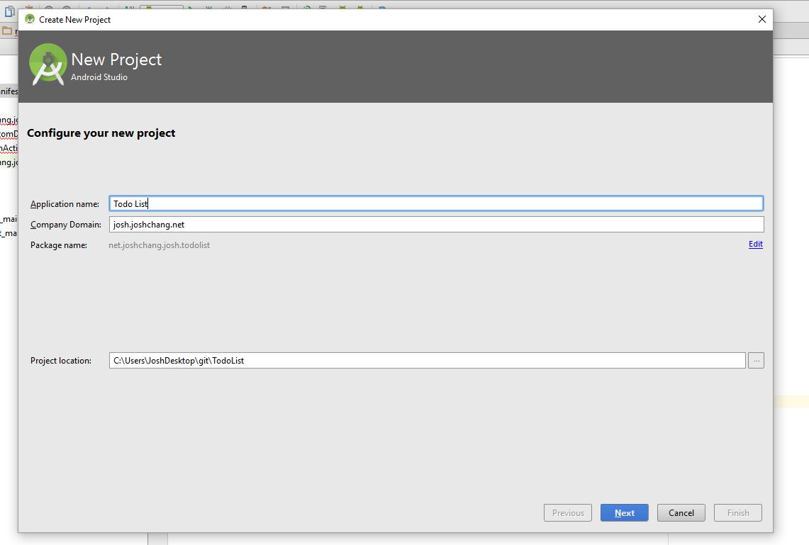
Create A New Project (API 16)

Slide 5
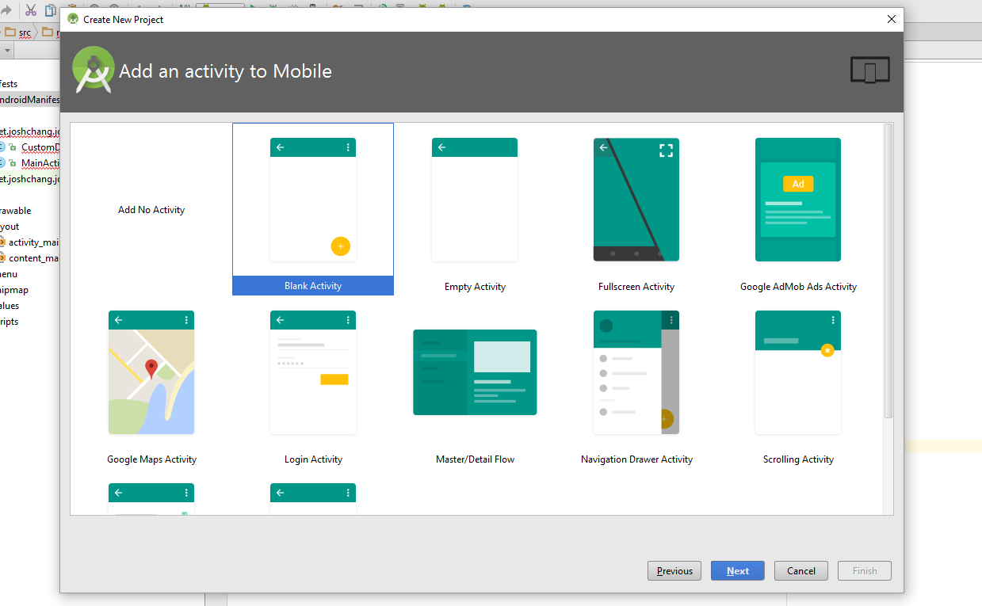
Choose Blank Activity

Slide 6
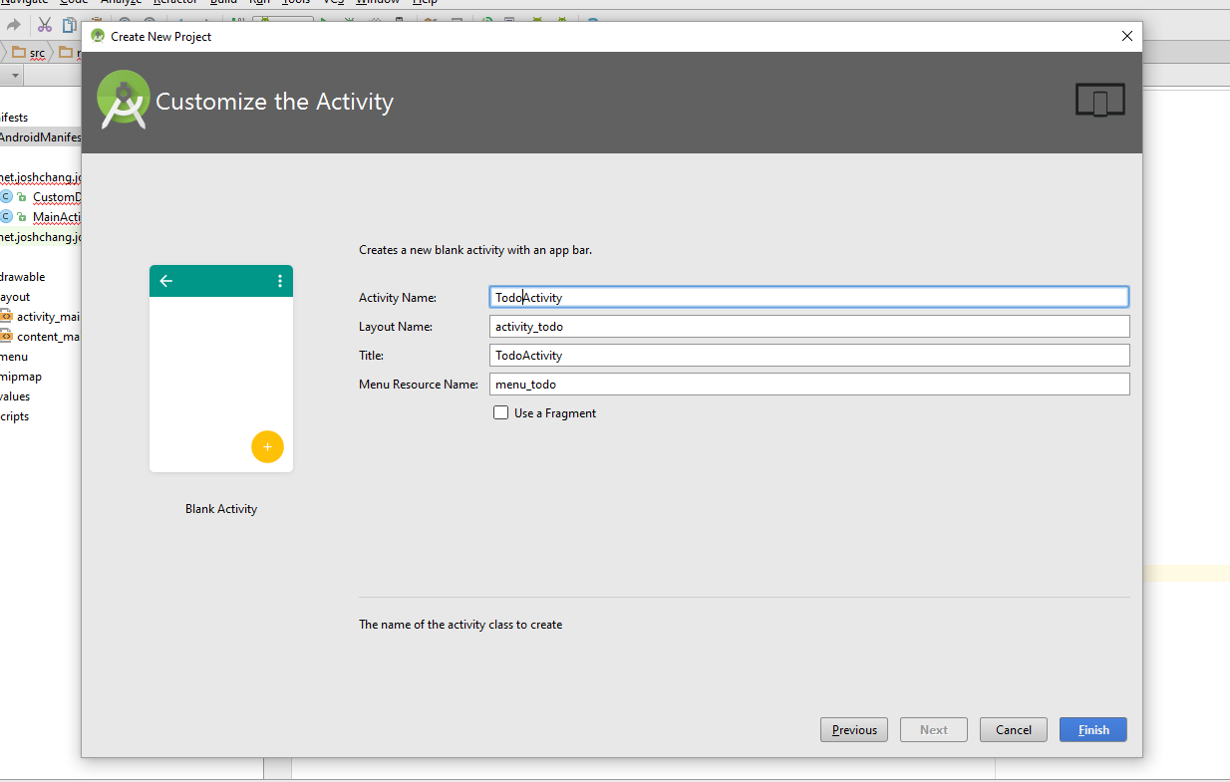
Name you activities
Title – Title that appears on your ActionBar
MenuResourceName – Name of menu that holds the elements in our ActionBar

Slide 7
Changes In Android Manifest
android:theme="@style/Theme.AppCompat.Light.NoActionBar">
Inside the application NoActionBar has been chosen as the scheme. It’s used to make sure we don’t have 2 ActionBars

Slide 8
Taking A Peak at activity_todo.xml
The only 2 Important things to note:
<android.support.design.widget.AppBarLayout <android.support.v7.widget.Toolbar/> </android.support.design.widget.AppBarLayout>
Used to display our Action Bar in our XML
<include layout="@layout/content_todo" />
Includes the actual layout we’re going to put our widgets in. activity_todo.xml is just a container with an Action Bar.

Slide 9
Looking at menu_todo.xml
<menu xmlns:android="http://schemas.android.com/apk/res/android" xmlns:app="http://schemas.android.com/apk/res-auto" xmlns:tools="http://schemas.android.com/tools" tools:context="net.joshchang.josh.todolist.TodoActivity"> <item android:id="@+id/action_settings" android:orderInCategory="100" android:title="@string/action_settings" app:showAsAction="never" /> </menu>
Notice that inside our menu tags, we have item tags.
A menu represents our Action Bar as a whole
An item represents each of the buttons that’s available inside our Action Bar

Slide 10
Important Menu Attributes
app:showAsAction=""
Display options
Never: Will always be in the Action Bar dropdown menu
ifRoom: If space, will be on the Action Bar, otherwise in the dropdown menu
Always: Item will always be on the ActionBar
android:icon="@android:drawable/btn_plus"
The icon that your option will appear as
Resources of all icon: https://design.google.com/icons/#ic_album

Slide 11
Looking In Our TodoActivity.java
public class TodoActivity extends AppCompatActivity { @Override protected void onCreate(Bundle savedInstanceState) { super.onCreate(savedInstanceState); setContentView(R.layout.activity_todo); Toolbar toolbar = (Toolbar) findViewById(R.id.toolbar); // 1) gets our Toolbar setSupportActionBar(toolbar); // 2) adds our Toolbar to our Action Bar FloatingActionButton fab = (FloatingActionButton) findViewById(R.id.fab); fab.setOnClickListener(new View.OnClickListener() { @Override public void onClick(View view) { Snackbar.make(view, "Replace with your own action", Snackbar.LENGTH_LONG) .setAction("Action", null).show(); } }); } // 3) Creates the Action Bar @Override public boolean onCreateOptionsMenu(Menu menu) { // Inflate the menu; this adds items to the action bar if it is present. getMenuInflater().inflate(R.menu.menu_todo, menu); return true; } // 4) Sets what happens when the user clicks on one of the items defined in menu_todo.xml @Override public boolean onOptionsItemSelected(MenuItem item) { // Handle action bar item clicks here. The action bar will // automatically handle clicks on the Home/Up button, so long // as you specify a parent activity in AndroidManifest.xml. int id = item.getItemId(); //noinspection SimplifiableIfStatement if (id == R.id.action_settings) { return true; } return super.onOptionsItemSelected(item); } }

Slide 12
Important Action Bar Functions
Methods
public boolean onCreateOptionsMenu(Menu menu) – Similar to the onCreate method for activities, this is where we create our ActionBar
public boolean OnOptionsItemSelected(MenuItem item) – This is called whenever a user clicks on an item on our option menu
We are given the item which the user clicks which we can use to determine which button the user clicked!

Slide 13
Delete The FloatingActionBar in TodoActivity.java
public class TodoActivity extends AppCompatActivity { @Override protected void onCreate(Bundle savedInstanceState) { super.onCreate(savedInstanceState); setContentView(R.layout.activity_todo); Toolbar toolbar = (Toolbar) findViewById(R.id.toolbar); // 1) gets our Toolbar setSupportActionBar(toolbar); // 2) adds our Toolbar to our Action Bar } // 3) Creates the Action Bar @Override public boolean onCreateOptionsMenu(Menu menu) { // Inflate the menu; this adds items to the action bar if it is present. getMenuInflater().inflate(R.menu.menu_todo, menu); return true; } // 4) Sets what happens when the user clicks on one of the items defined in menu_todo.xml @Override public boolean onOptionsItemSelected(MenuItem item) { // Handle action bar item clicks here. The action bar will // automatically handle clicks on the Home/Up button, so long // as you specify a parent activity in AndroidManifest.xml. int id = item.getItemId(); //noinspection SimplifiableIfStatement if (id == R.id.action_settings) { return true; } return super.onOptionsItemSelected(item); } }

Slide 14
Delete the FloatingActionBar in activity_todo.xml
<?xml version="1.0" encoding="utf-8"?> <android.support.design.widget.CoordinatorLayout xmlns:android="http://schemas.android.com/apk/res/android" xmlns:app="http://schemas.android.com/apk/res-auto" xmlns:tools="http://schemas.android.com/tools" android:layout_width="match_parent" android:layout_height="match_parent" android:fitsSystemWindows="true" tools:context="net.joshchang.josh.todolist.TodoActivity"> <android.support.design.widget.AppBarLayout android:layout_width="match_parent" android:layout_height="wrap_content" android:theme="@style/AppTheme.AppBarOverlay"> <android.support.v7.widget.Toolbar android:id="@+id/toolbar" android:layout_width="match_parent" android:layout_height="?attr/actionBarSize" android:background="?attr/colorPrimary" app:popupTheme="@style/AppTheme.PopupOverlay" /> </android.support.design.widget.AppBarLayout> <include layout="@layout/content_todo" /> </android.support.design.widget.CoordinatorLayout>

Slide 15
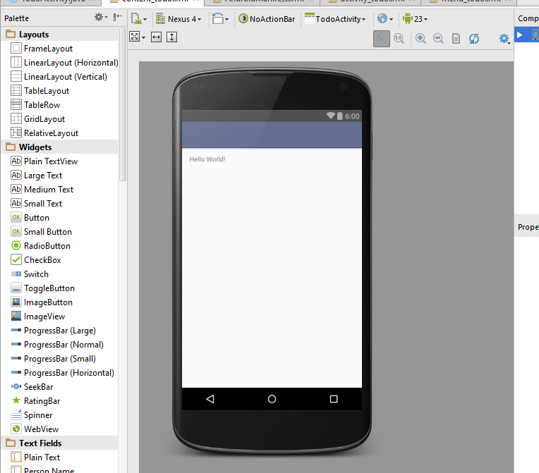
The Result: No Bottom Right Button

Slide 16
Current Goal
Goal: We want to be able to create and interact with our Action Bar that will be used to add new tasks to our Todo List
What we need to do:
Add new items in our menu
Write code that’ll do something based off of what icon was clicked

Slide 17
Add a New Item To Our Menu
<menu xmlns:android="http://schemas.android.com/apk/res/android" xmlns:app="http://schemas.android.com/apk/res-auto" xmlns:tools="http://schemas.android.com/tools" tools:context="net.joshchang.josh.todolist.TodoActivity"> <item android:id="@+id/action_add" android:icon="@android:drawable/ic_input_add" android:title="@string/action_settings" app:showAsAction="always" /> <item android:id="@+id/action_star" android:icon="@android:drawable/star_big_on" android:title="@string/action_settings" app:showAsAction="always" /> </menu>
We deleted the existing one to create 2 new ones.

Slide 18
Using Our Items In TodoActivity.java
public class TodoActivity extends AppCompatActivity { @Override protected void onCreate(Bundle savedInstanceState) { super.onCreate(savedInstanceState); setContentView(R.layout.activity_todo); Toolbar toolbar = (Toolbar) findViewById(R.id.toolbar); // 1) gets our Toolbar setSupportActionBar(toolbar); // 2) adds our Toolbar to our Action Bar } // 3) Creates the Action Bar @Override public boolean onCreateOptionsMenu(Menu menu) { // Inflate the menu; this adds items to the action bar if it is present. getMenuInflater().inflate(R.menu.menu_todo, menu); return true; } // 4) Sets what happens when the user clicks on one of the items defined in menu_todo.xml @Override public boolean onOptionsItemSelected(MenuItem item) { // Handle action bar item clicks here. The action bar will // automatically handle clicks on the Home/Up button, so long // as you specify a parent activity in AndroidManifest.xml. int id = item.getItemId(); // 5) Created a quick Toast to show that something happens when the user // clicks on our buttons if (id == R.id.action_add) { Toast.makeText(this, "You clicked the plus button!", Toast.LENGTH_SHORT).show(); } else if (id == R.id.action_star) { Toast.makeText(this, "You clicked the star button!", Toast.LENGTH_SHORT).show(); } return super.onOptionsItemSelected(item); } }

Slide 19
What was done?
if (id == R.id.action_add) { Toast.makeText(this, "You clicked the plus button!", Toast.LENGTH_SHORT).show(); } else if (id == R.id.action_star) { Toast.makeText(this, "You clicked the star button!", Toast.LENGTH_SHORT).show(); }
We added if statement to detect which item was clicked and use Toast to show the result

Slide 20
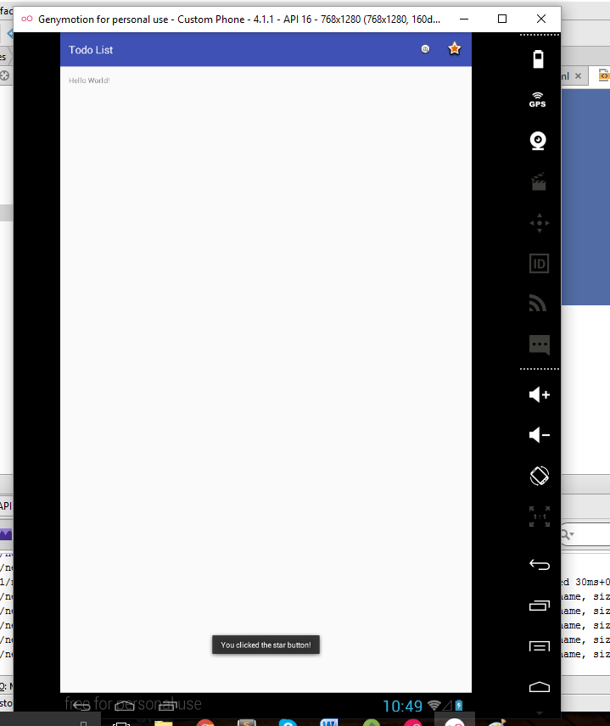
Try It Out!

Slide 21
That’s the Basic for ActionBars!

